Slide 1
KINSHIP RELATION DETECTION
(IDENTIFYING IF PEOPLE ARE RELATED)
PRANAY RAWAT
2K17/CO/230

Slide 2
INTRODUCTION
KINSHIP refers to sharing of selected characteristics among organisms through nature .
Kinship verification is the task of judging if two individuals are kin or not and has been widely studied in the field of psychology and neuroscience.
Dataset would be Families in the wild dataset with with over 11,932 family photos of 1,000 families.

Slide 3
MACHINE LEARNING MODELS
With the use of deep learning architecture, the task of face recognition showed highly improved accuracy as compared to previous classical methods. The state of the art models can now outperform even humans when trained with huge datasets .
FACENET
FaceNet is the name of the facial recognition system that was proposed by Google Researchers in 2015 in the paper titled FaceNet: A Unified Embedding for Face Recognition and Clustering.They proposed an approach in which it generates a high-quality face mapping from the images using deep learning architectures such as ZF-Net and Inception. Then it used a method called triplet loss as a loss function to train this architecture. Let’s look at the architecture in more detail.

Slide 4
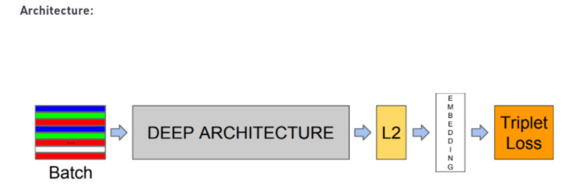

Slide 5
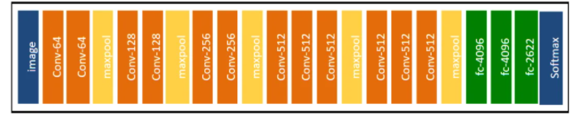
DeepFace
VGG-Face is deeper than Facebook’s DeepFace, it has 22 layers and 37 deep units. The architecture of vgg is given below.

Slide 6
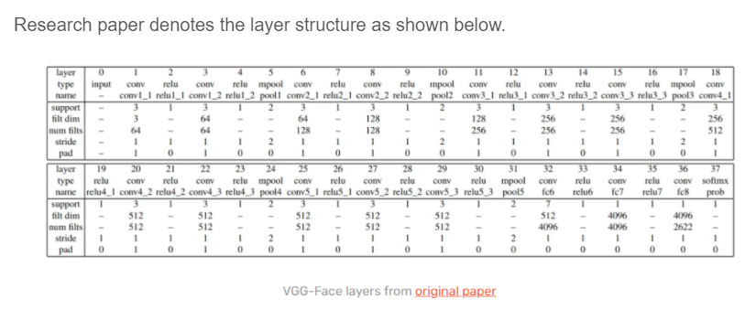
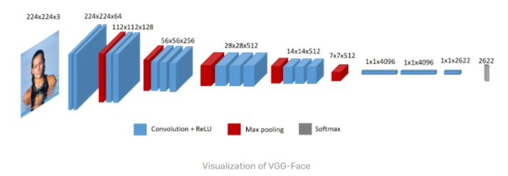

Slide 7
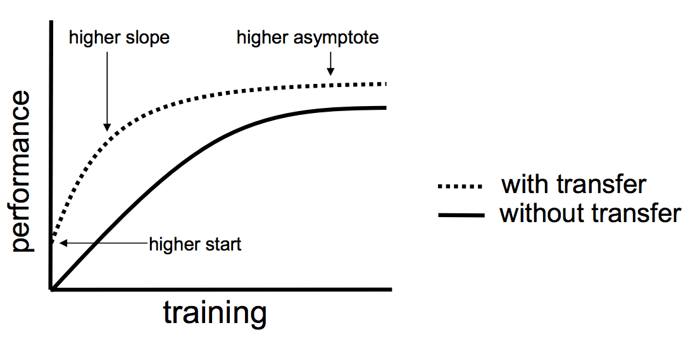
TRANSFER LEARNING
Transfer learning is a research problem in machine learning that focuses on storing knowledge gained while solving one problem and applying it to a different but related problem. For example, knowledge gained while learning to recognize cars could apply when trying to recognize trucks. Given below is the model performance of transfer vs traditional learning.

Slide 8
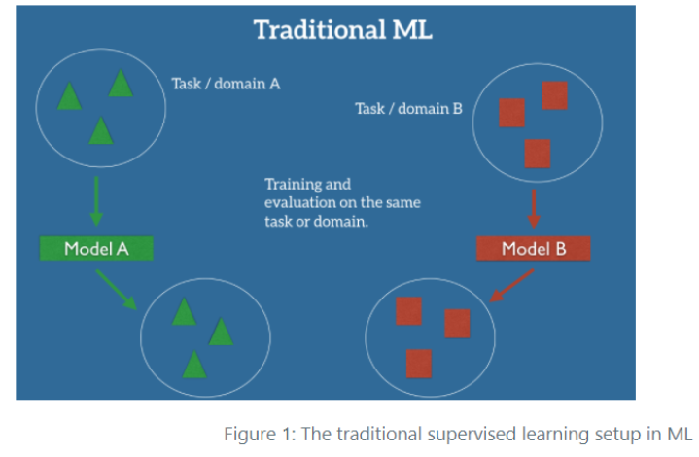
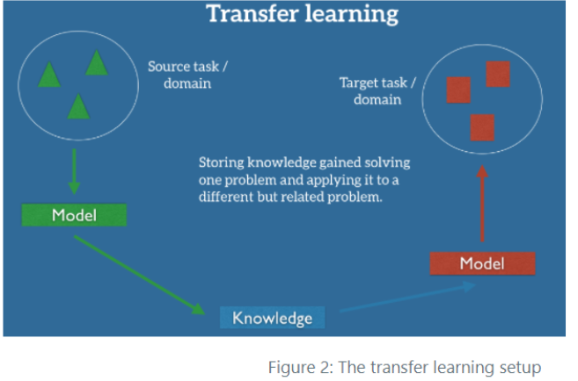

Slide 9
APPLICATIONS OF TRANSFER LEARNING
Real world simulations.
Gaming
Image Classification
Zero shot translation
Sentiment Classification

Slide 10
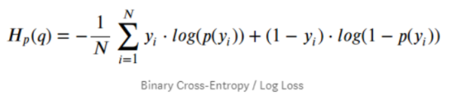
MODEL PARAMETERS
LOSS FUNCTION AND DEFINITION
TRAINING
Finally,the model was trained. Using callbacks to store and use the trained model at various points, the final code of training looks like this.You can see here we are using the ‘generate’ helper function to generate batches of images of size 16. After training for several epochs the model converged and the accuracy was not improving from there.

Slide 11
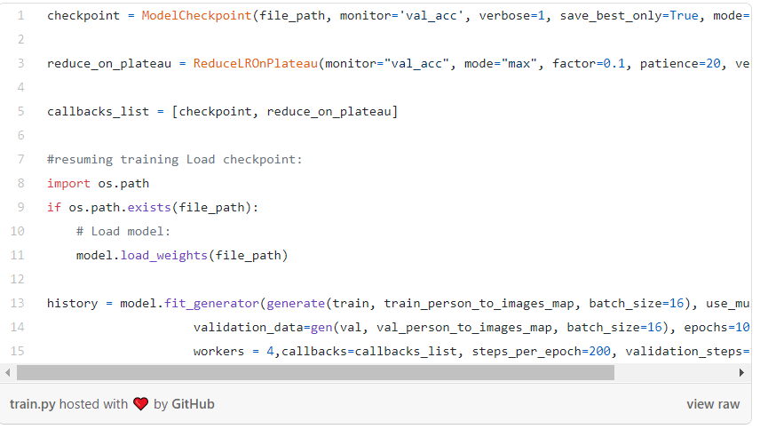
Below is a code snippet from the project defining the model parameters and all the callback functions.

Slide 12
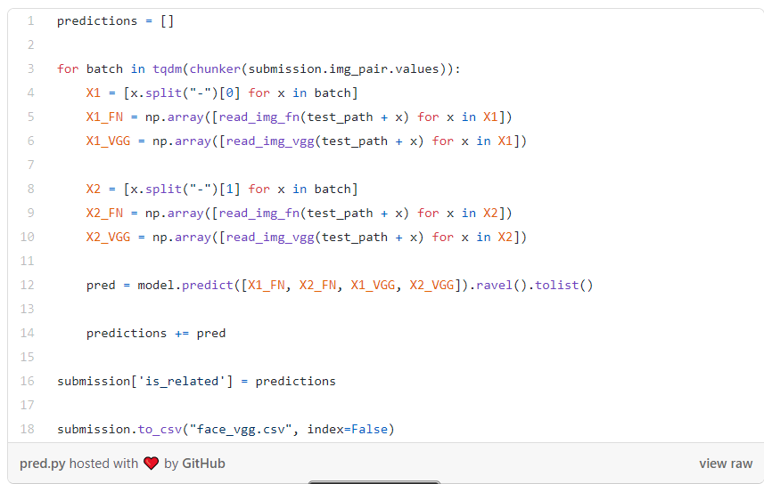
EVALUATION AND RESULT
Now we can use this trained model to predict the probabilities given two input images. We will be using the ‘sample_submission.csv’ file provided by Kaggle to do so. This file contains pairs of images and the model needs to predict the probability of kin relationship.This file ‘face_vgg.csv’ is then submitted to Kaggle to check the score. The model performed well and gave the AUC score of ‘0.887’ on private lb and ‘0.881’ on public lb.

